Slide 1

Billboard Song Prediction Project
Teammates: Sarah D. Hood, Jini Hassan, Ryan Eccleston-Murdock, Wasif Khan, Angeli Lucila, Ivana Korak

Slide 2
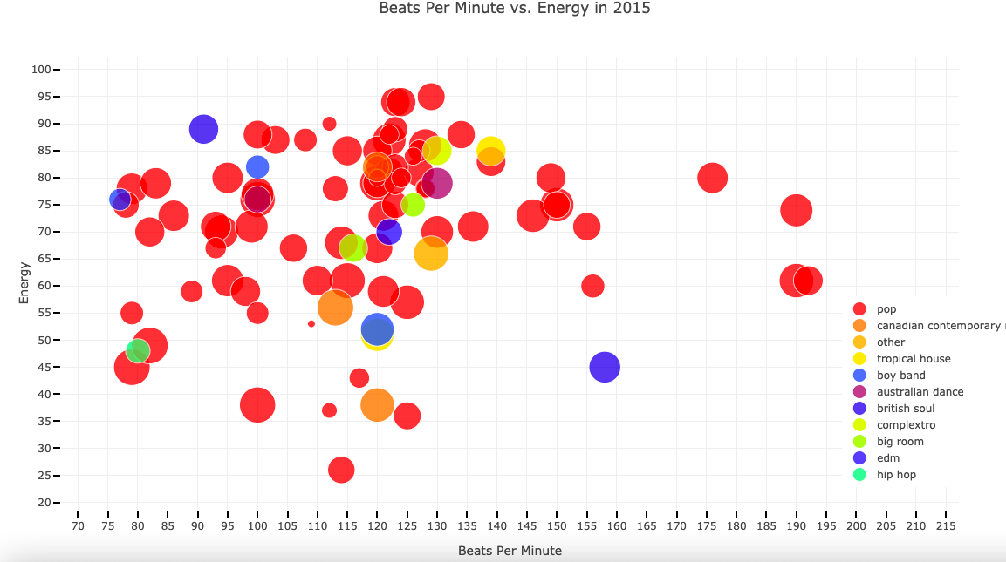
Inspiration and Goal
Building on past project
Rise of British Soul - could we predict?
Try to predict song attributes/genres that will be in the next hit songs
Models:
Time Series?
Logarithmic
SVM
Plan:
Billboard weekly top 100 songs
Predict next week’s hits

Slide 3
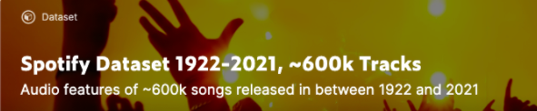

Datasets
CSV: Spotify songs with attributes 1922-2021
CSV: Billboard weekly top 100 1958-2020
Scraping: Billboard weekly top 100 2021
Calls to Spotify API for unique Spotify IDs and/or song attributes

Slide 4
Workflow Overview
Clean existing CSVs
Scraping Billboard
Make Spotify API calls
Join CSVs on Spotify ID
Prepare the data for modelling
Run the models

Slide 5
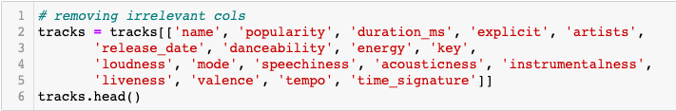
CSV cleaning: code
Cutting to 2018 - 2020
Data types: datetime
Cleaning strings
Filling NaNs
Removing unnecessary columns

Slide 6
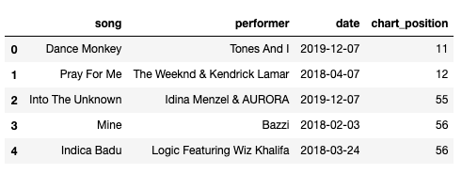
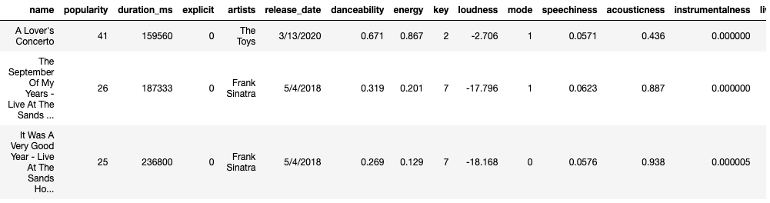
CSV cleaning: Results

Slide 7
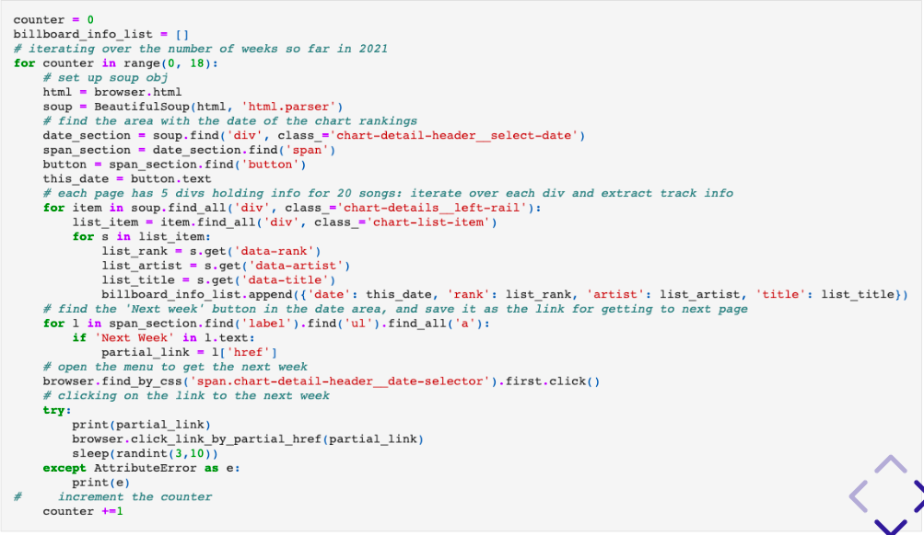
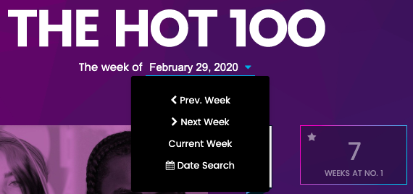
Billboard Scraping: Code & Challenges

Slide 8
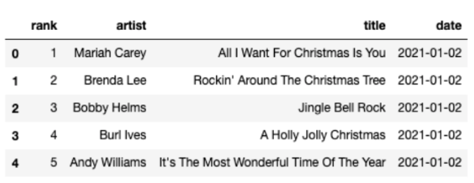
Billboard Scraping: Results

Slide 9
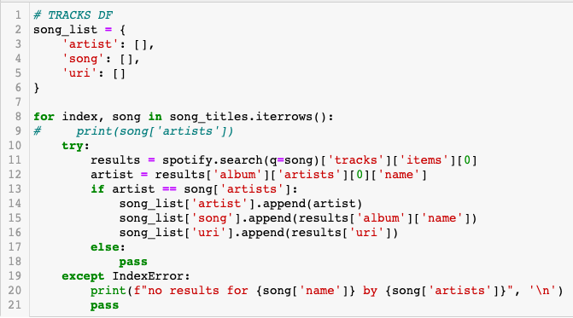
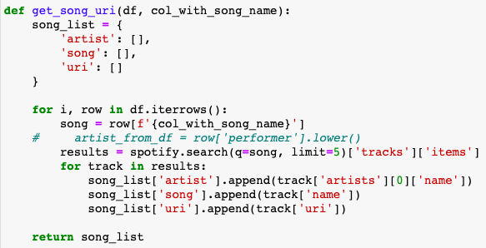
Spotify API calls

Slide 10

Spotify API calls: Challenges
Time
Results per track

Slide 11
Change of Direction!

Slide 12
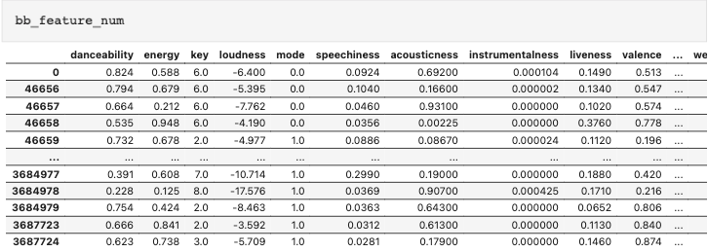
Problems with our current inputs...
Preliminary models: song attributes don’t have much predictive ability
Better factors
Time limit: only 2018 - 2020 data

Slide 13
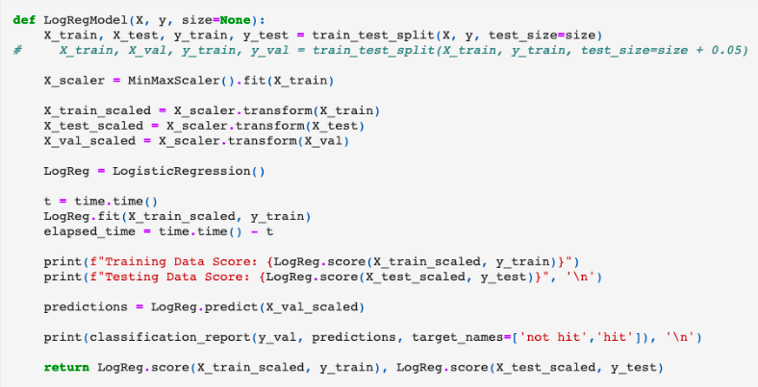
Logarithmic Model: Code

Slide 14
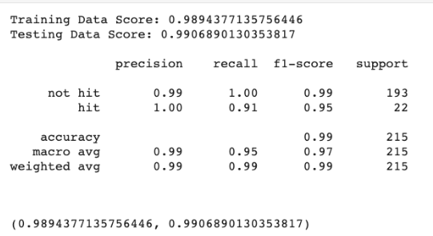
Logarithmic Model: Results

Slide 15
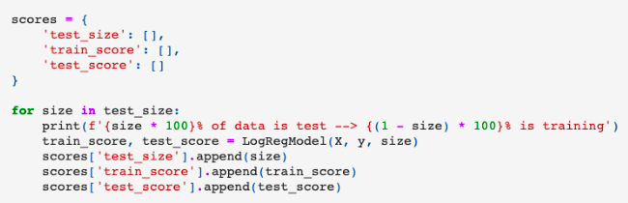
Modulating Test and Training Percentages

Slide 16
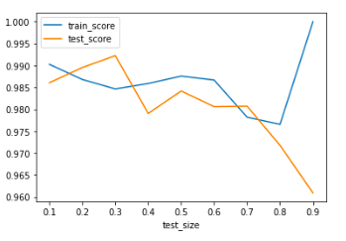
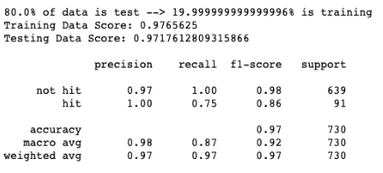

Slide 17
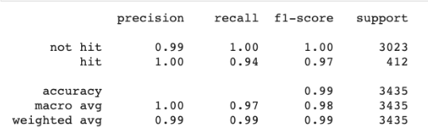
SVM Model

Slide 18
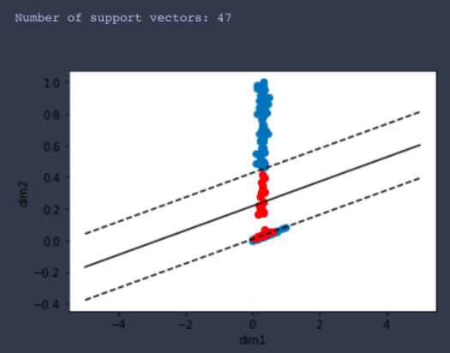
SVM: Graphed

Slide 19
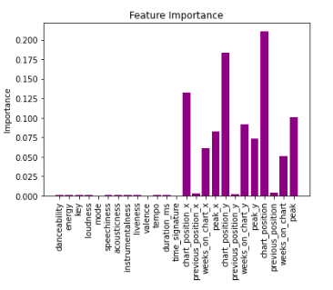
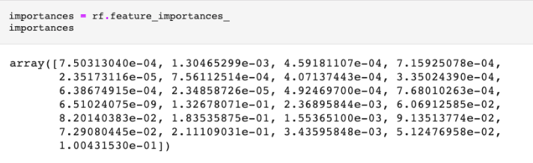
Random Forest: Scoring the Model

Slide 20
Future Directions/Do-Overs
Getting advice about type of model earlier
Not clipping the 2018-2020 dataset to take away the weeks on the chart and top ranking columns
Using the Spotify API less, as the song attributes actually weren’t very important to the model
Add in the 2021 data to make it up to date
Make the model live on a website, with data in a database, updated every week

Slide 21
Thank you!
Model advice
Repo example
Help with scraping

Slide 22
Questions?

